Slide 1
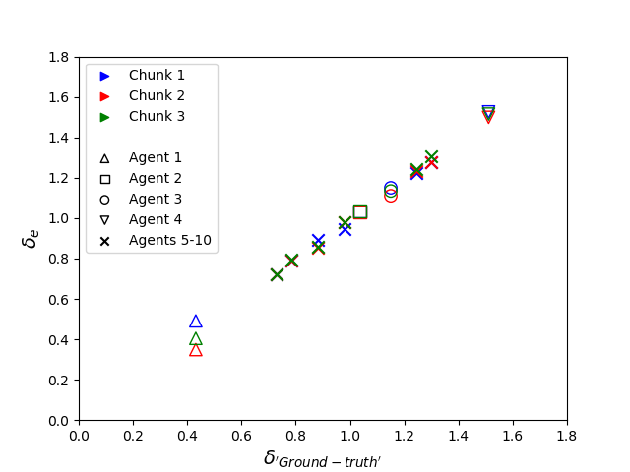

CPT-agents; $δ_{GT} vs. δ_{e}$

Slide 2
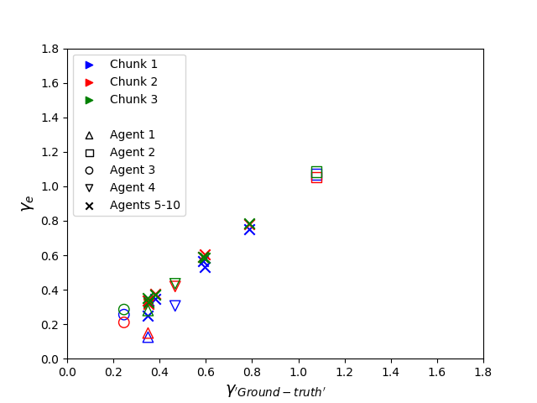

CPT-agents; $γ_{GT} vs. γ_{e}$

Slide 3
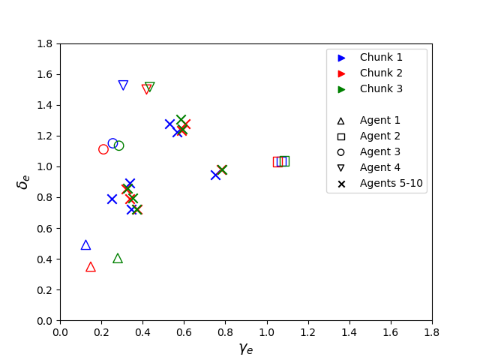

CPT-agents; $γ_{e} vs. δ_{e}$

Slide 4
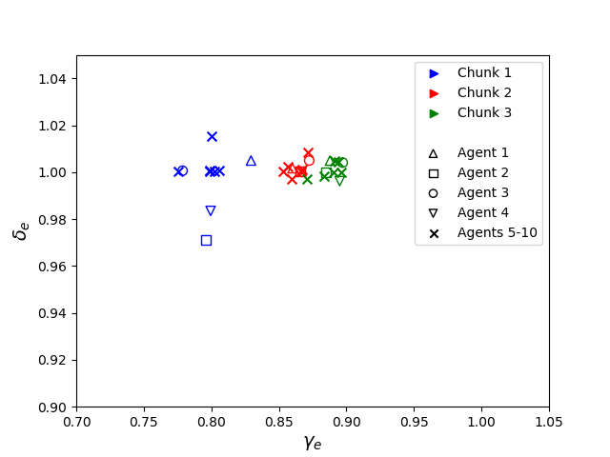

LML-agents; $γ_{e} vs. δ_{e}$

Slide 5
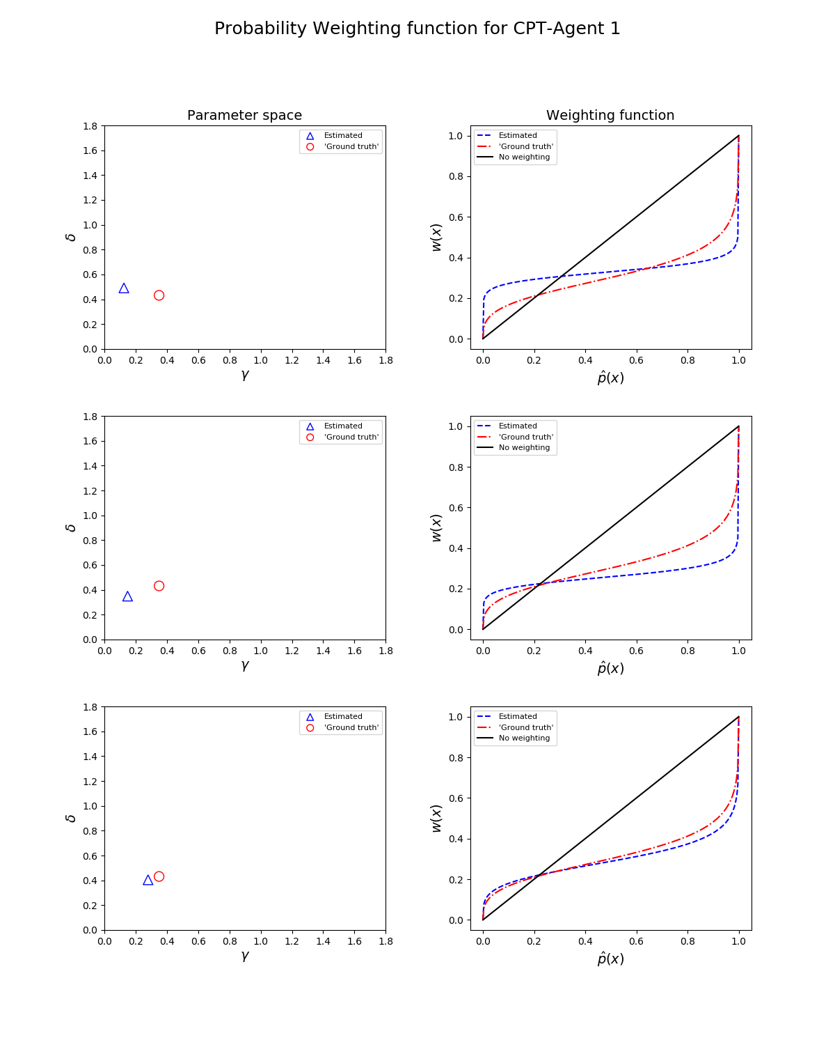
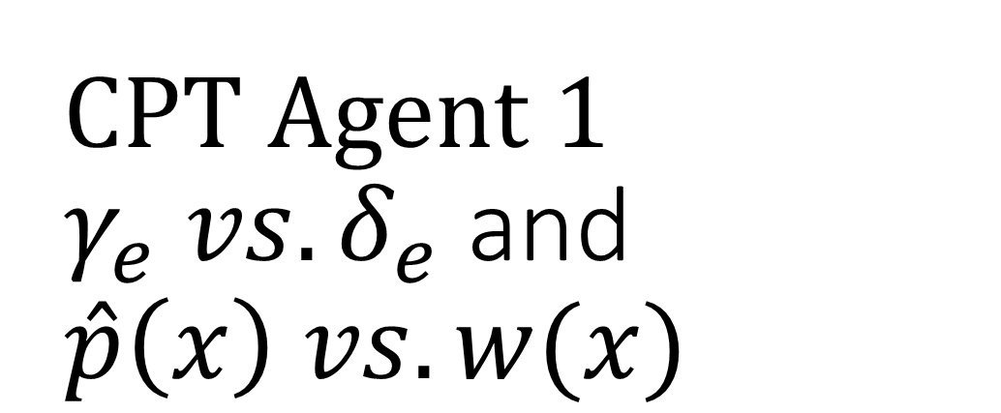
CPT Agent 1 $γ_{e} vs. δ_{e}$ and $\hat{p}\left(x\right) vs. w(x)$

Slide 6
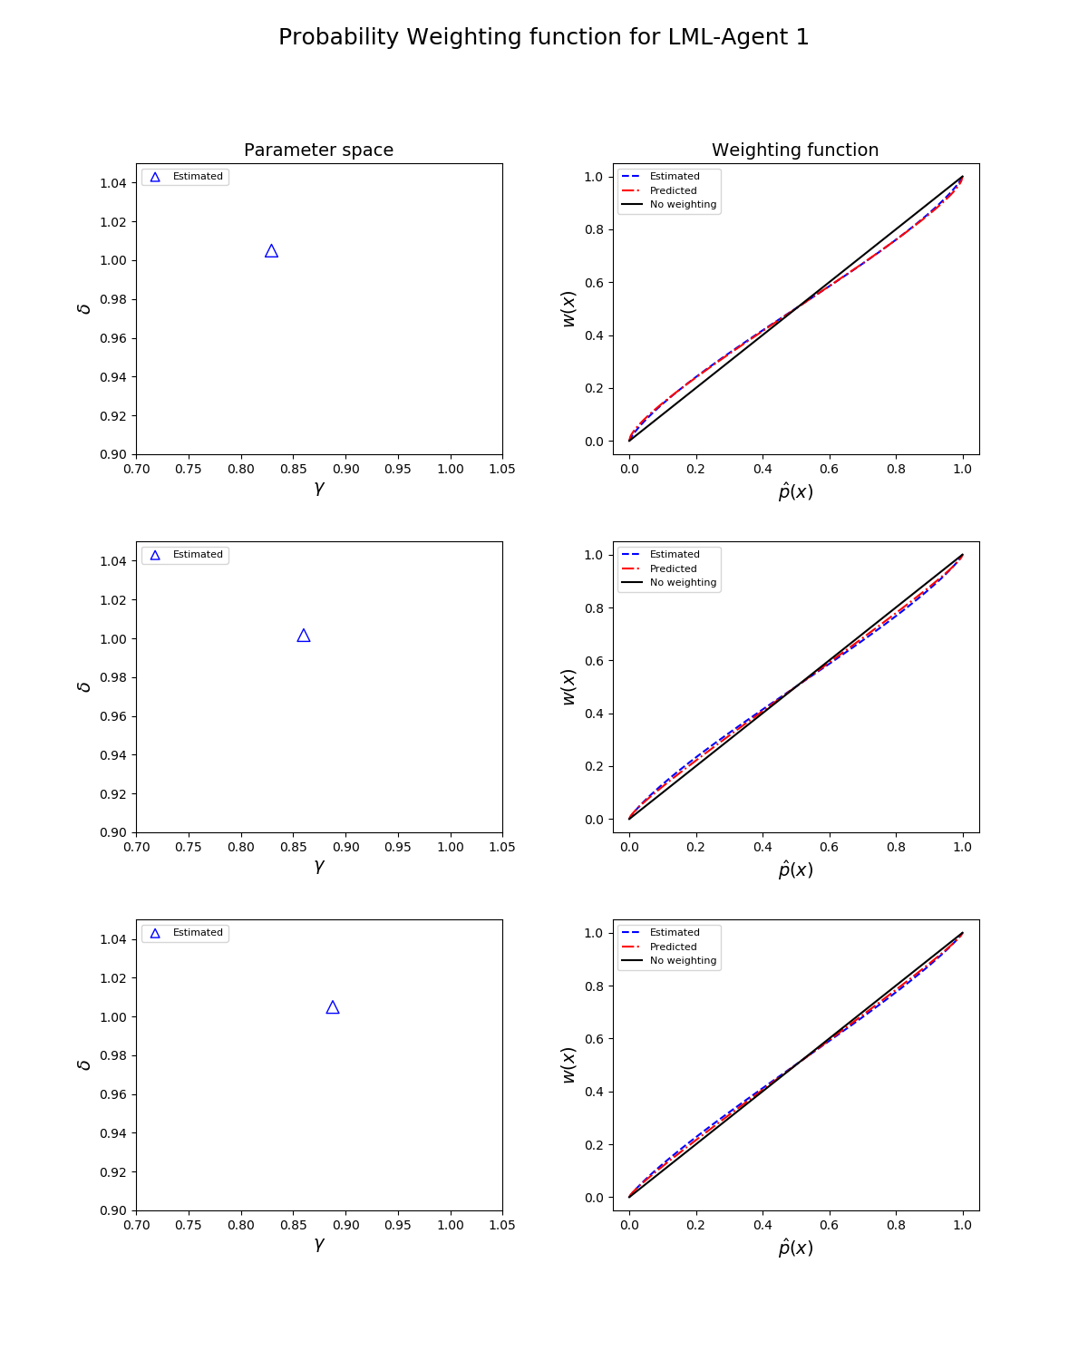
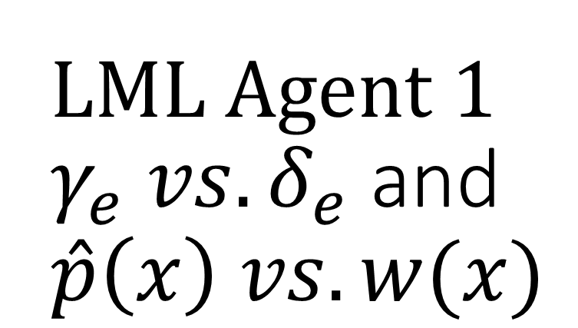
LML Agent 1 $γ_{e} vs. δ_{e}$ and $\hat{p}\left(x\right) vs. w(x)$

Slide 7
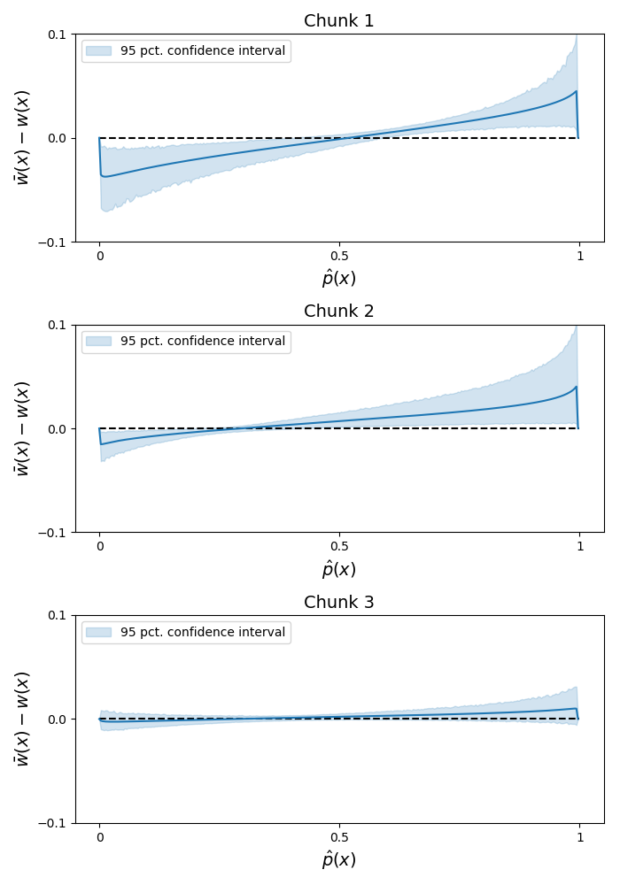
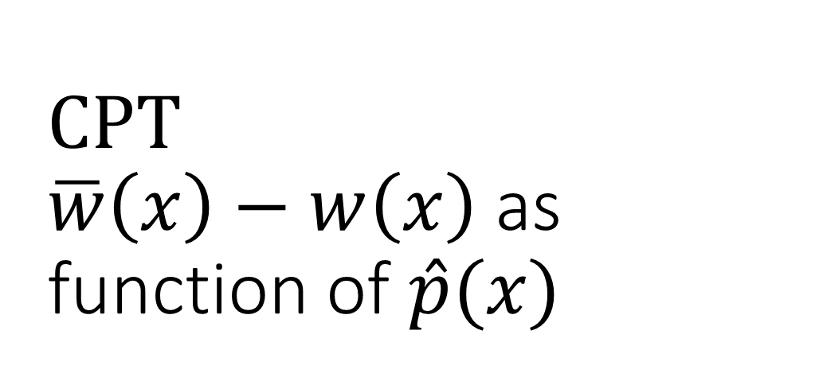
CPT $\overline{w}\left(x\right)−w\left(x\right)$ as function of $\hat{p}(x)$

Slide 8
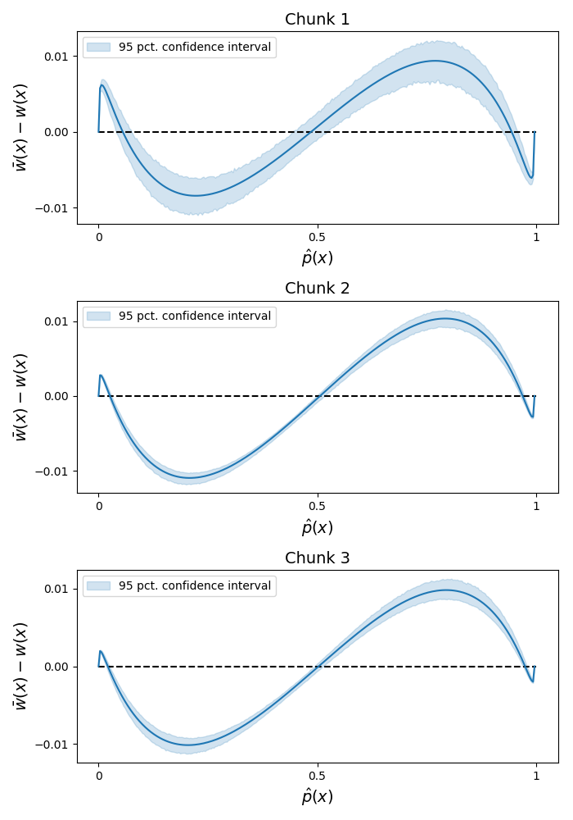
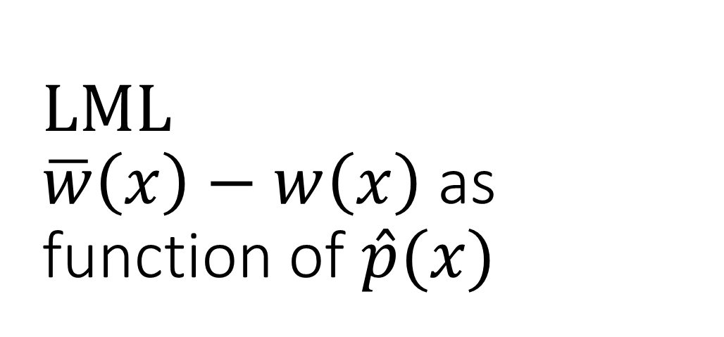
LML $\overline{w}\left(x\right)−w\left(x\right)$ as function of $\hat{p}(x)$

Slide 9
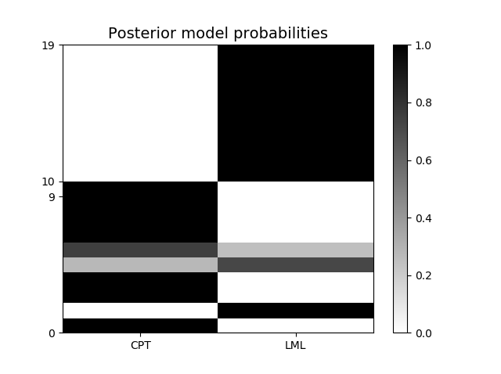
Model selection

Slide 10
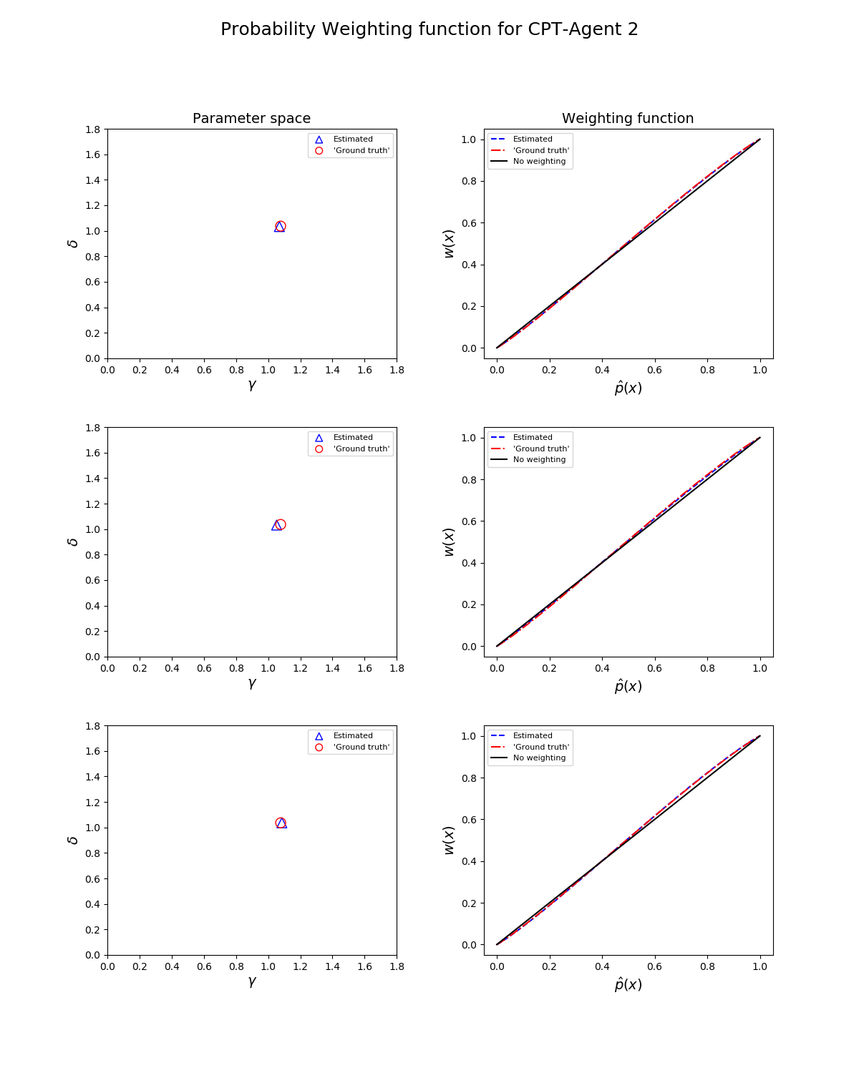
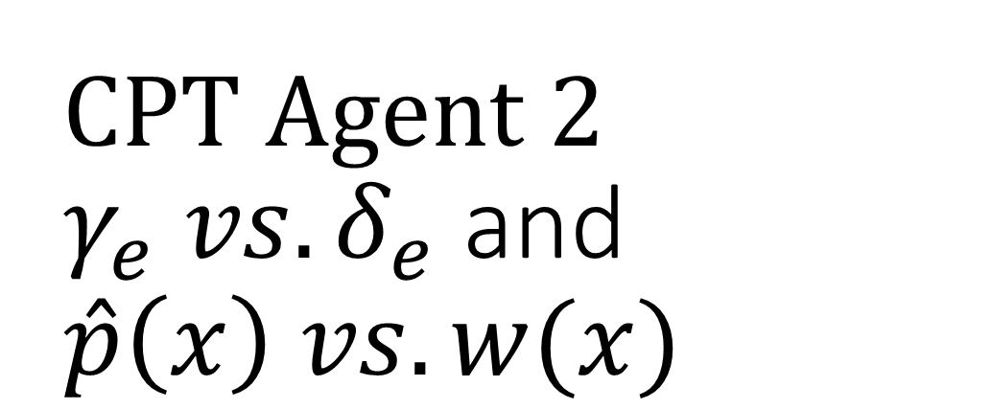
CPT Agent 2 $γ_{e} vs. δ_{e}$ and $\hat{p}\left(x\right) vs. w(x)$

